Slide 1
Supervised ML : v2
Lakshay Kumar, Atharv Vadhera, Shyam Sindhia

Slide 2
Problem Statement
Relation between different brain waves and sleepiness to understand which factors are most predictive of driver drowsiness.

Slide 3
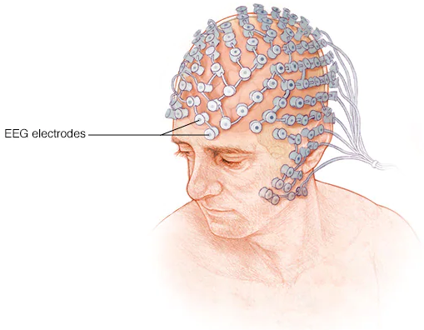
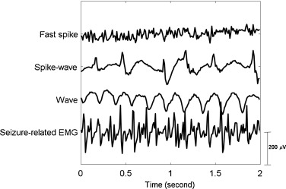
EEG?
An electroencephalogram (EEG) is a test that measures electrical activity in the brain

Slide 4
Data Collection
“The driver would wear the NeuroSky MindWave headset connected by a USB stick to the laptop and we would collect EEG signals from their brain. The NeuroSky mindwave headset is a single channel headset that measures the voltage between an electrode resting on the frontal lobe (forehead) and two electrodes (one ground and one reference) each in contact with one earlobe. The drivers were instructed to be awake or asleep and their EEG signals were recorded accordingly.”
Authors

Slide 5
Dataset
Wave Name | When They Are High | When They Are Low
Attention | High values indicate high mental focus or concentration. | Low values indicate poor focus or distraction.
Meditation | High values indicate high levels of relaxation or calmness. | Low values indicate stress or agitation.s
Delta (1-3 Hz) | High values are prominent during deep sleep and restorative states. | Low values are seen during awake states and light sleep.
Theta (4-7 Hz) | High values are associated with light sleep, drowsiness, and meditative states. | Low values are seen during alert, wakeful states.
Low Alpha (8-11 Hz) | High values indicate a relaxed but alert state, often seen with eyes closed. | Low values are seen during active mental engagement or stress.
High Alpha (8-11 Hz) | High values indicate deep relaxation and calmness. | Low values are observed during active cognitive tasks or stress.
Low Beta (12-29 Hz) | High values are associated with active thinking, problem-solving, and alertness. | Low values are seen during relaxation or passive states.
High Beta (12-29 Hz) | High values indicate high alertness, stress, and intense mental activity. | Low values are observed during relaxation or low engagement.
Low Gamma (30-100 Hz) | High values reflect heightened cognitive processing and complex mental tasks. | Low values are seen during low cognitive demand or relaxation.
High Gamma (30-100 Hz) | High values indicate advanced cognitive functions, perception, and high focus. | Low values are observed during states of reduced cognitive activity or relaxation.

Slide 6
Output
If the driver is sleepy or not?

Slide 7




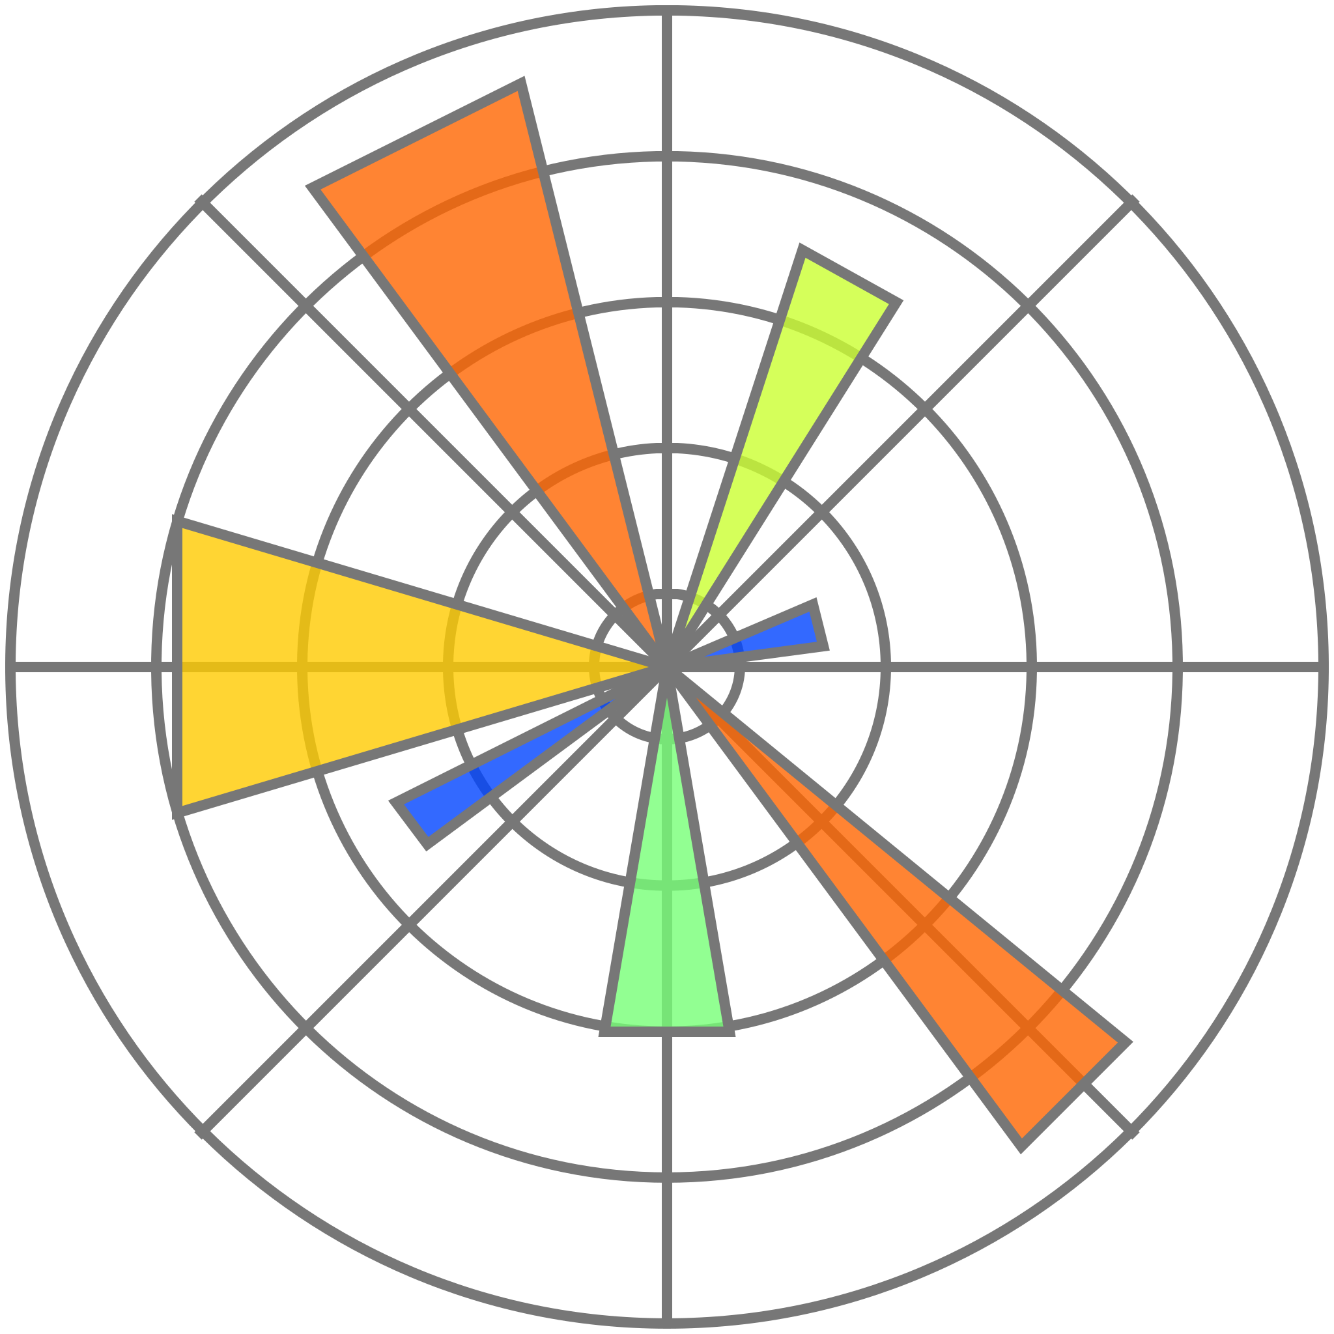
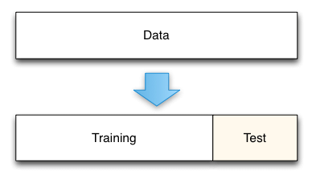
Block Diagram
Sleepy Driver EEG Dataset
Result &
Interpretation
Handling Dataset
Visualisation
Logistic Regression
Decision Tree
Randomforest
Test train split

Slide 8
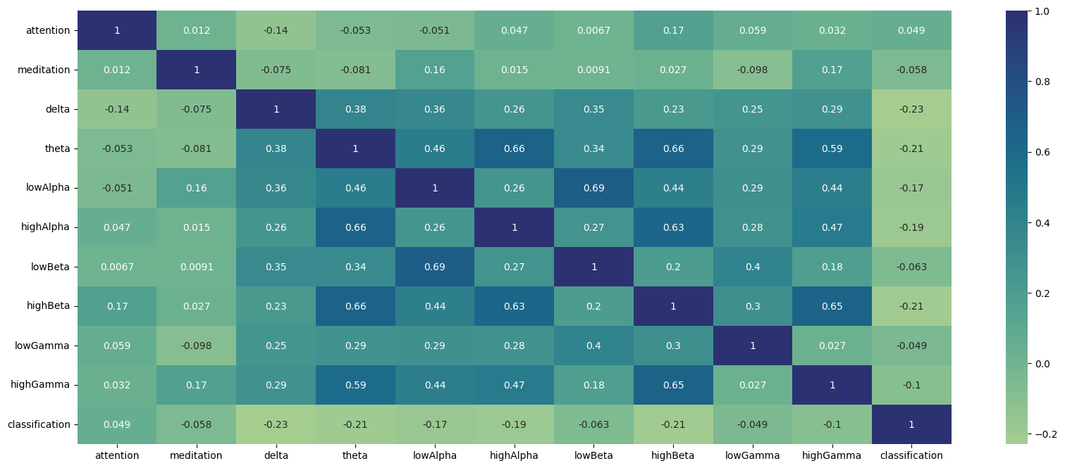
Correlation
X
X
X
X

Slide 9
Insight?
Delta waves show a negative correlation (-0.23), indicating higher values are associated with lower drowsiness likelihood, aligning with their presence in deep sleep.
Theta and High Beta waves exhibit moderate negative correlations (-0.21), suggesting higher values also indicate lower drowsiness likelihood.
Low Alpha and Low Beta features have weaker correlations, implying minimal impact on drowsiness prediction.

Slide 10
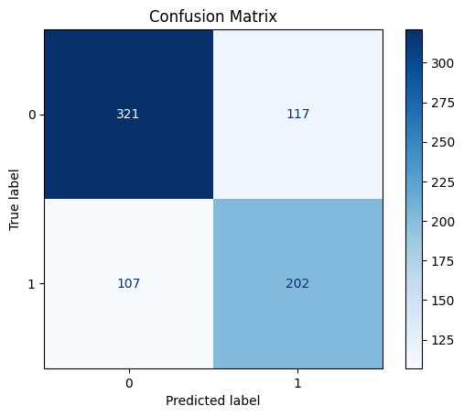
Logistic Regression
Accuracy : 0.70013
Precision : 0.7328
Assumes linear relationship between brainwaves and drowsiness!

Slide 11
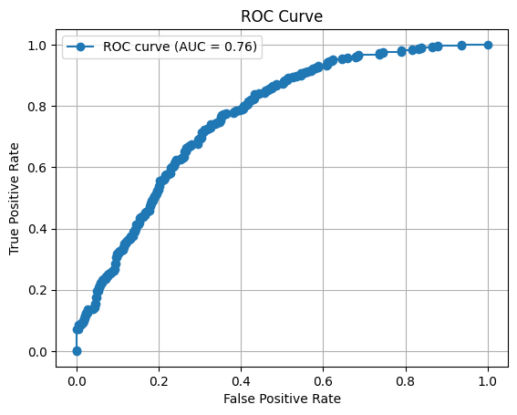
Logistic Regression
Fairly strong ability to differentiate between drowsy and non-drowsy drivers!

Slide 12
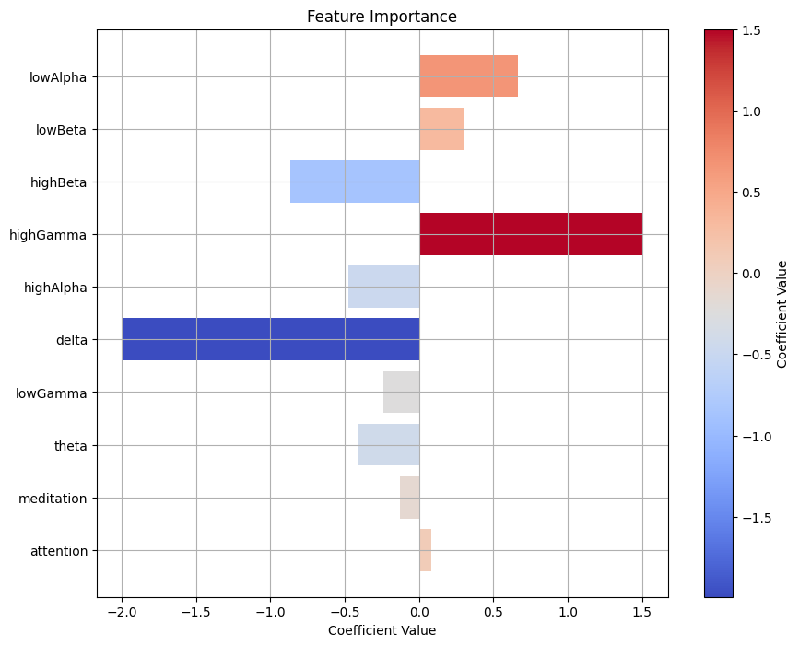
Logistic Regression
Wave | When they are high | When they are low
High Gamma (30-100 Hz) | High values indicate advanced cognitive functions, perception, and high focus. | Low values are observed during states of reduced cognitive activity or relaxation.
Delta (1-3 Hz) | High values are prominent during deep sleep and restorative states. | Low values are seen during awake states and light sleep.

Slide 13
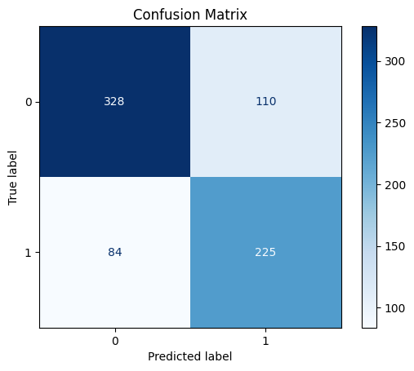
Decision Tree Classifier
Accuracy - 0.7402
vs
Logistic Regression
Accuracy - 0.70013

Slide 14
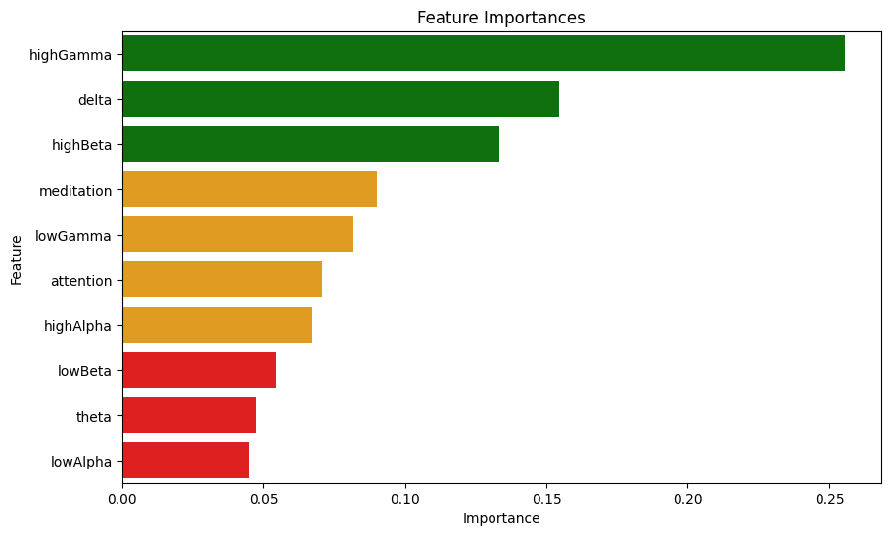
Decision Tree Classifier
Wave | When they are high | When they are low
High Gamma (30-100 Hz) | High values indicate advanced cognitive functions, perception, and high focus. | Low values are observed during states of reduced cognitive activity or relaxation.
Delta (1-3 Hz) | High values are prominent during deep sleep and restorative states. | Low values are seen during awake states and light sleep.
High Beta (12-29 Hz) | High values indicate high alertness, stress, and intense mental activity. | Low values are observed during relaxation or low engagement.

Slide 15
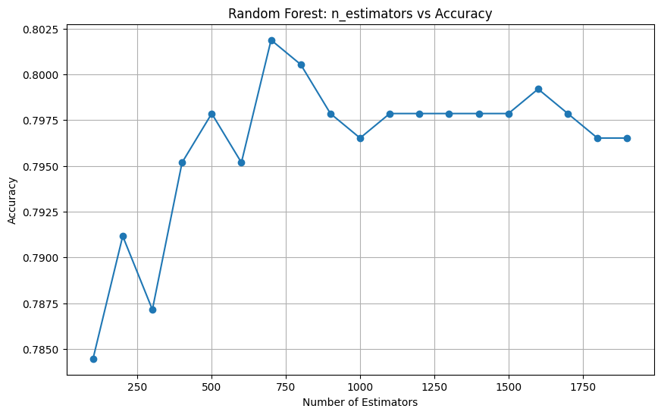
Random Forest
Max Accuracy at 700 trees ~ 80.19%
The Random Forest model not only reached the highest accuracy of 80.19% with 700 trees, but it also highlights how this method outperform simpler models by reducing overfitting and capturing more complex interactions in brainwave patterns.

Slide 16
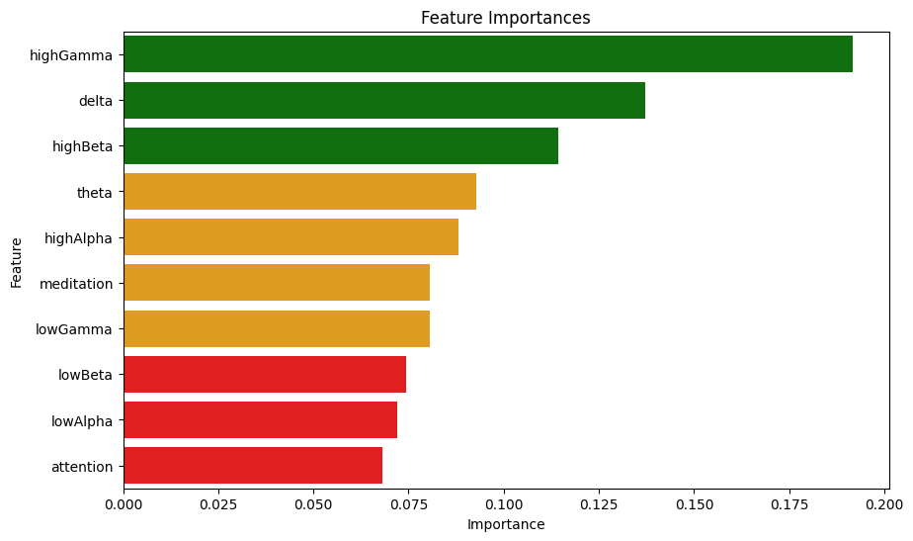
Random Forest
Feature Importance in Predicting Driver Drowsiness
Top Predictors:
High Gamma Waves: Mental fatigue, cognitive processing
Delta Waves: Deep sleep, alertness, early drowsiness
High Beta Waves: Active mental engagement, stress, alertness dips
Moderate Importance:
Theta Waves: Alertness-relaxation transitions
High Alpha Waves: Wakefulness-drowsiness boundary
Less Important:
Attention
Low Beta
Low Alpha

Slide 17
Comparison
 | Logistic Regression | Decision Tree | Random Forest (700 trees)
Accuracy | 0.700 | 0.743 | 0.801
Sensitivity | 0.751 | 0.792 | 0.819
Most important features | High Gamma, Delta, High beta | High Gamma, Delta, High Beta | High Gamma, Delta, High Beta
Least important features | Attention & Meditation | Theta & Low Alpha | Low Alpha & Attention

Slide 18
Future Scope
Conduct a longitudinal study that tracks changes in brain wave activity over long driving periods. This could help identify the progression of drowsiness and pinpoint critical time windows where drivers are most vulnerable to falling asleep.
Explore how external factors like road conditions, noise, temperature, and lighting affect brain wave patterns and drowsiness. This could help in understanding the interaction between environmental stressors and driver fatigue.
Investigate the development of real-time feedback systems that monitor brain wave activity and provide immediate alerts or interventions (e.g., auditory, visual, or tactile) to keep drivers awake. Assess the efficacy and user acceptance of such systems.

Slide 19
Thanks!

